Slide 1
ESP32 Sleep modes

Slide 2
Full power
WIFI
Peripherals
Cores
RTC
Bluetooth
Coprocessor
Light sleep
Peripherals
Bluetooth
WIFI
Peripherals
Bluetooth
WIFI
Cores
Coprocessor
RTC
Cores
Coprocessor
RTC
Deep sleep

Slide 3
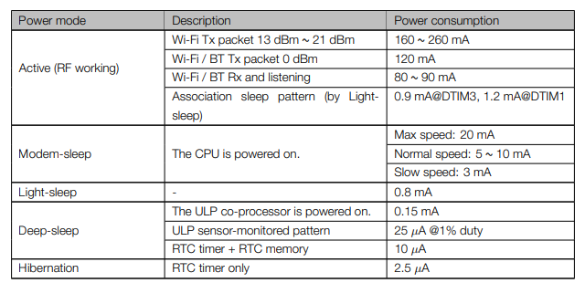
Current Consumption
From the esp32 Datasheet https://lastminuteengineers.com/datasheets/esp32-datasheet-en.pdf

Slide 4
Wake up modes
Light sleep | Deep sleep
Timer | Timer
Touch pad | Touch pad
External wakeup | External wakeup
(ULP Coprocessor ADC) | (ULP Coprocessor ADC)
(ULP Coprocessor i2c) | (ULP Coprocessor i2c)
GPIO wakeup
UART wakeup
https://docs.espressif.com/projects/esp-idf/en/latest/api-reference/system/sleep_modes.html#overview

